Slide 1
POULTRY SCIENCE: Hatchery Operation
Unit 11

Slide 2
Poultry Science: Hatchery Operation & Fertilized Eggs
Unit 11: Segment 1
Hatchery Process & Responsibilities

Slide 3
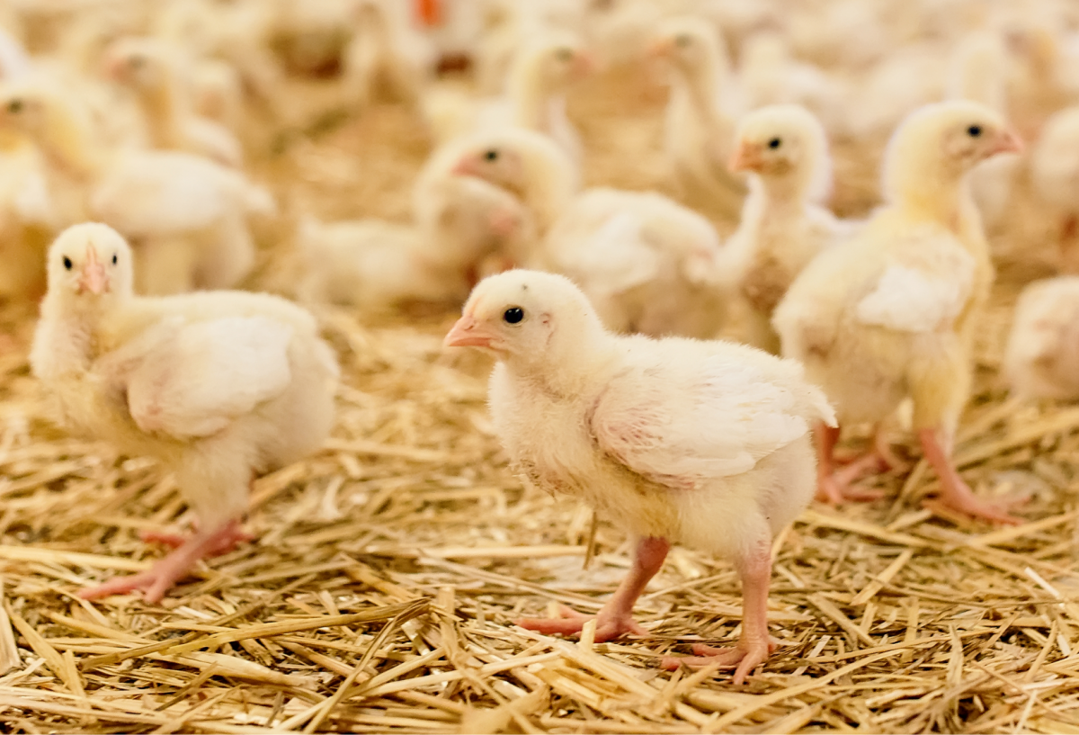
The Hatchery
The hatchery is where the fertile eggs are stored and incubated until they hatch and are transported to their respective farms.
This is a very important step, as the incubation process can be finicky and any element being off can ruin hatchability and fertility resulting in wasted time, money, and supply.

Slide 4
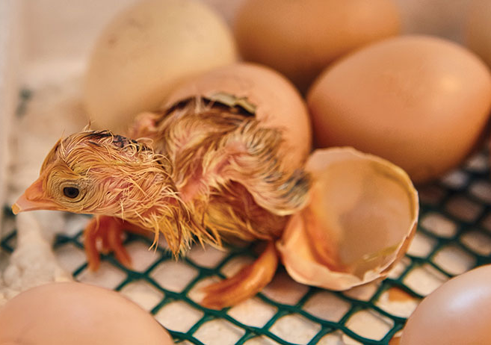
Fertilized Egg Handling: To the Hatchery
Eggs are collected 2-3 times per DAY and placed in coolers at the broiler breeder farm.
Eggs are picked up 2-3 times per WEEK to be taken to the hatchery and placed in climate-controlled coolers.
Transport to hatchery could be anywhere up to 100 miles from the farm.
Upon arrival, eggs are put in hatchery cooler at 65-67ºF. These coolers should be extremely clean to minimize contamination!

Slide 5
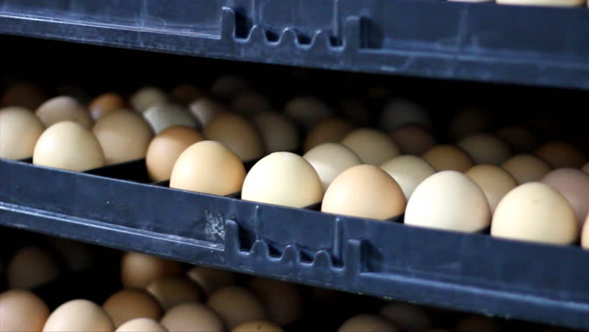
Fertilized Egg Handling: Incubation at the Hatchery
Incubation – process in which an embryo in a fertilized egg develops into a baby chick and hatches out using a particular mixture of heat, humidity, positioning, and time.
Incubators have been used since the early Egyptians, who used clay ovens!

Slide 6
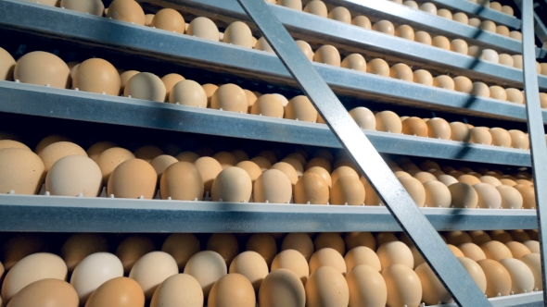
Fertilized Egg Handling: Incubation at the Hatchery
Natural incubation is done by the hen sitting on her egg(s), but commercially it is done using an incubator in a hatchery. Hen incubation results in fewer viable eggs.
Chicken eggs need 21 days to hatch (504-512 hours of incubation time)
Turkey eggs need 28 days to hatch
Some strains may need a little more or less incubation time and temperature.
Age of breeder flock can impact incubation time, also!

Slide 7
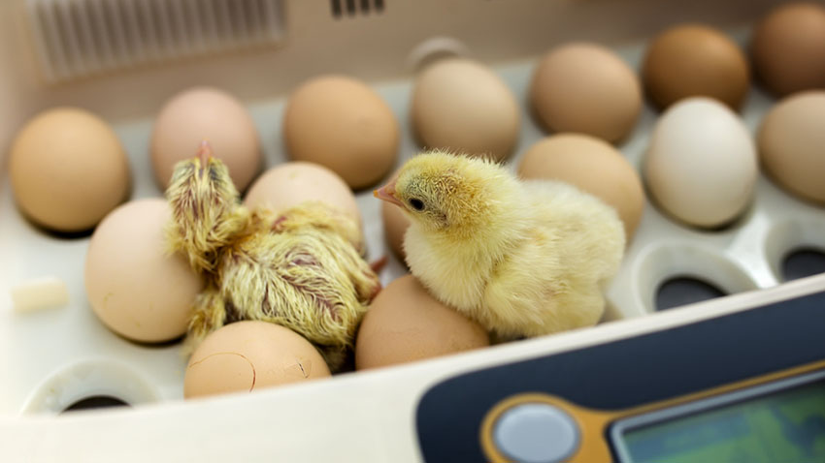
Incubation Rules
Temperature: 99.5-99.9ºF -> This drives the entire process!
Relative Humidity: 55-75%
Turning: Rotate eggs once every hour for 18 days
Fresh air or Ventilation: Removes excess heat and CO₂
Remove heat after 10 days as embryo will begin to make heat.

Slide 8
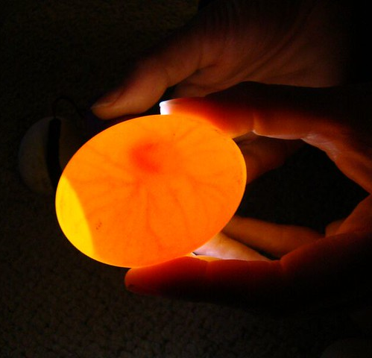
Candling
Candling – using light to see inside the egg to monitor embryonic development in fertilized eggs or grading of infertile table eggs.
Eggs need to be incubated 10-12 days before candling.
Need to candle 400-600 eggs for a good estimate.
Remove clear eggs so only viable eggs move on (looking for development of blood vessels).
Candle Analysis Tells Us/The Hatchery:
Estimate of fertility
Early dead mortality
Some mid-deads
Cracked eggs
Upside down eggs
Contaminated eggs

Slide 9
Fertile vs. Infertile Egg: How to Tell the Difference
An unincubated fertilized egg looks like a doughnut with a hole in the middle.
An unincubated infertile egg’s germinal disc is a solid white disc.

Slide 10
Why didn’t the eggs hatch?
Egg was contaminated from a dirty nest, wet floors, or was laid on the ground outside of the nest. Yolk sac will be filled with bacteria if contaminated!
Abnormal Size and/or Shape
Egg was cracked from issue with collection schedule, being on the floor, or had a thin shell.
Not fertile
Handling & storage conditions and/or length or storage time

Slide 11
Poultry Science: Hatchery Operation & Fertilized Eggs
Unit 11: Segment 2
Embryology, Hatching & Chick Quality

Slide 12
What is “Embryology”?
Embryology – the development of the chicken (or other poultry) inside the egg.
The process of development begins at fertilization in the oviduct.
It takes a chicken egg 21 days to hatch, but development technically takes 22 days (1 day in the oviduct, and 21 under favorable conditions post-lay).

Slide 13
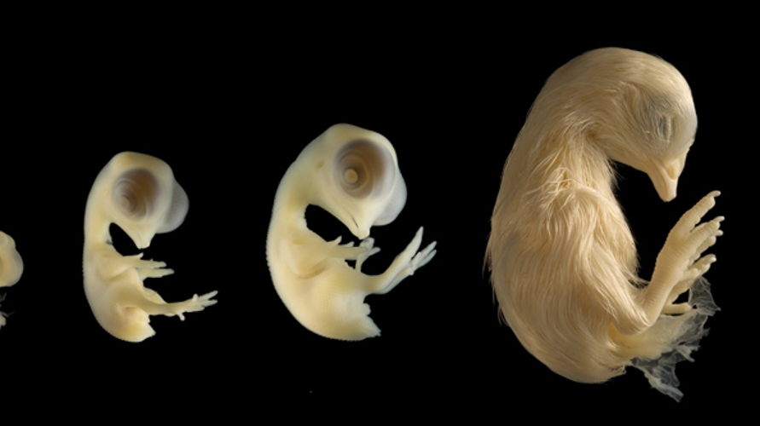
Embryo Development Process: The Beginning
Fertilization of the germinal disc by the sperm takes place in the Infundibulum approximately 15 minutes after the ovum is released form the follicle.
Cell division begins around 3 hours following fertilization in the Isthmus and continues while the egg passes along the oviduct!
When the sperm cell (½ of the chromosomes) fertilizes the germinal disc (other ½), it forms a single-cell zygote with full complement of chromosomes.

Slide 14
Embryo Development Process: The Beginning
The zygote then enters the Isthmus after 3+ hours and begins simple cell division. By the time it leaves the Isthmus it is made up of 8 cells and is officially an embryo.
Four hours later in the Shell Gland, the embryo has grown to 256 cells!

Slide 15
Embryo Development Process
The early differentiated tissues then develop into the major organ systems of the body:
Ectoderm (Outer Layer) | Mesoderm (Middle Layer) | Endoderm (Inner Layer)
Skin | Muscles | Digestive System
Feathers | Bones | Respiratory System
Beak | Blood | Endocrine System
Claws | Reproductive System
Eyes | Excretory System
Nervous System
Mouth
Vent Lining

Slide 16
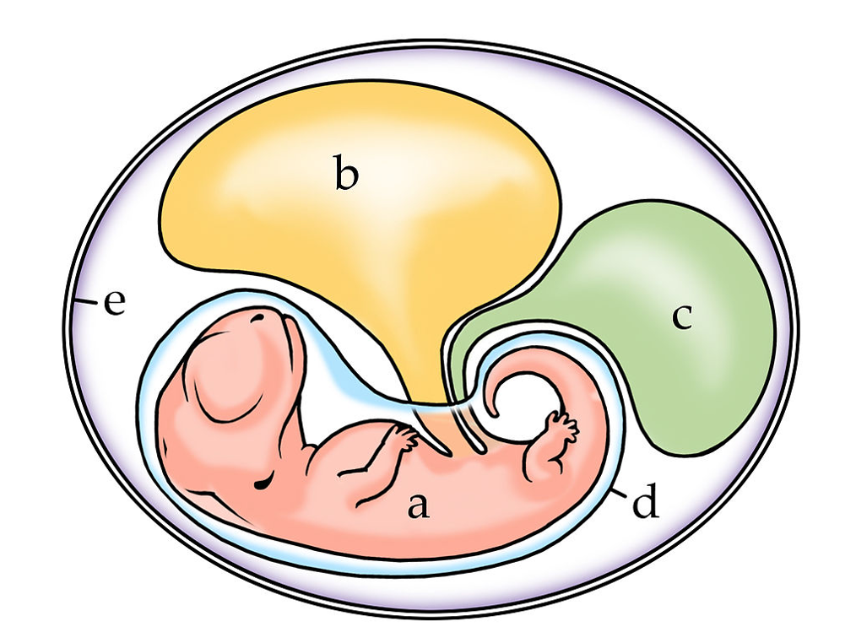
Extra-Embryonic Membranes
Embryo
Yolk sac
Allantois
Amnion
Chorion

Slide 17
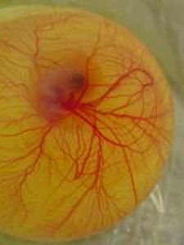
Extra-Embryonic Membranes
Yolk Sac
Covers the yolk and produces an enzyme that converts yolk material into a food source.
Any unused yolk post-hatch is drawn into the abdomen.
This last portion of yolk is used for nutrition while newly hatched chicks learn what to eat/drink and where it is located (2-3 days).
Notes:
The YSM develops from the hindgut of the embryo and begins to envelop the yolk in the initial phase of development. By d 5 of incubation (5E), the yolk is totally surrounded by the YSM,
Yolk lipid uptake is slow during the first 2 weeks of incubation and very rapid during the third and final week of incubation.

Slide 18
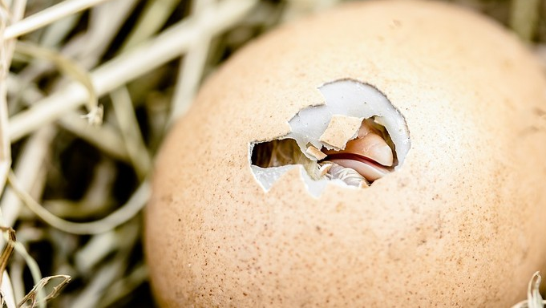
Extra-Embryonic Membranes
Amnion
The amnion forms a sac that fills with fluid in which the embryo floats.
Provides a shock-absorbing environment
Notes:
The amnion is a membrane that closely covers the embryo when first formed. It fills with the amniotic fluid which causes the amnion to expand and become the amniotic sac which serves to provide a protective environment for the developing embryo or fetus. The amnion, along with the chorion, the yolk sac and the allantois form a protective sac around the embryo.

Slide 19
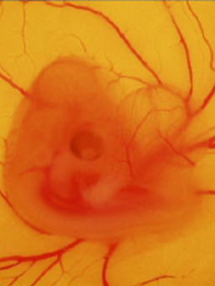
Extra-Embryonic Membranes
Allantois
The allantois is a circulatory system-infused membrane driven by the new embryo heart.
When fully developed, the allantois completely surrounds the embryo.
Functions:
Respiratory: the developing embryo respires (O₂ in, CO₂ out) but doesn’t have the system to do it, so the allantois completes gas exchange.
Excretory: removes waste products from embryonic metabolism
Digestive: it provides access to both the nutrition in the albumen and calcium in the eggshell

Slide 20
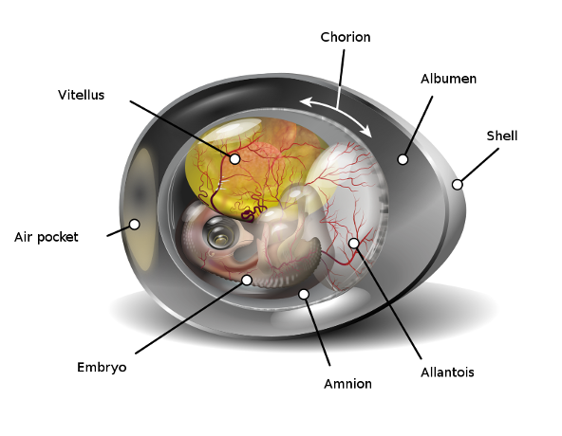
Extra-Embryonic Membranes
Chorion
The chorion fuses the inner shell membrane to the allantois and helps that membrane carry out its functions.

Slide 22
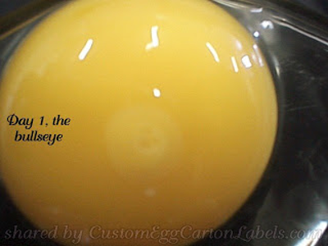
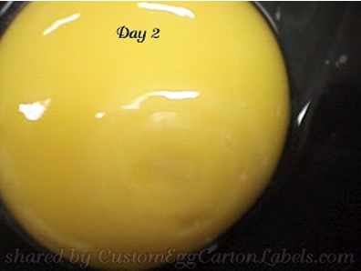
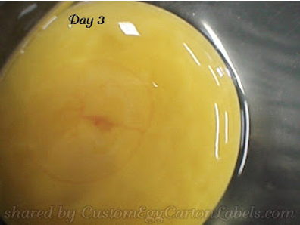
Daily Embryonic Development
Day 1: Appearance of embryonic tissue.
Day 2: Tissue development is visible. Blood vessels appear.
Day 3: Heart begins beating, and blood vessels are clearly visible.

Slide 23
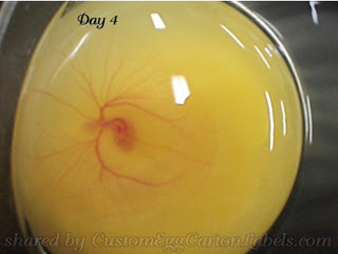
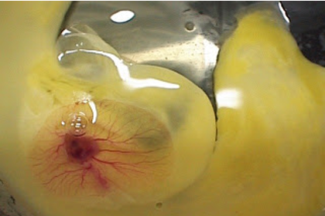
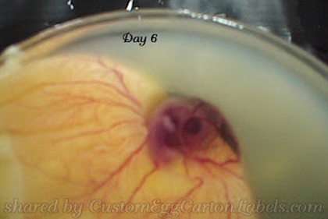
Daily Embryonic Development
Day 4: Eye pigmented.
Day 5: Appearance of elbows and knees.
Day 6: Appearance of beak. Voluntary movement begins.

Slide 24
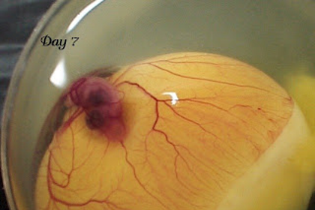
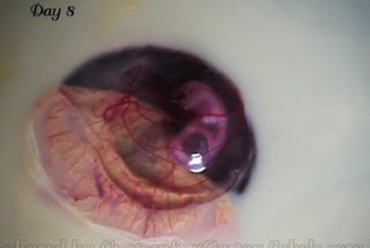
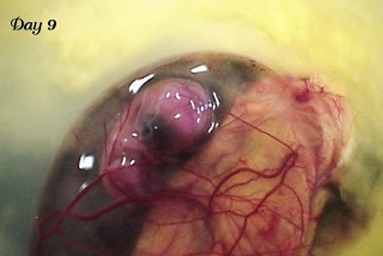
Daily Embryonic Development
Day 7: Comb growth begins. Egg tooth appears on beak.
Day 8: Feather tracts seen. Upper and lower beak equal in length.
Day 9: Embryo starts looking bird-like. Mouth opening occurs.

Slide 25
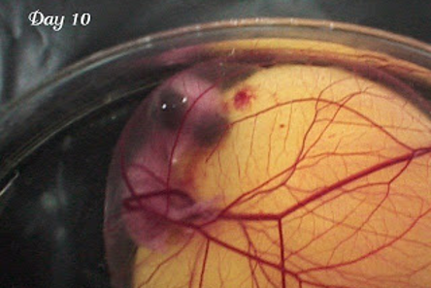
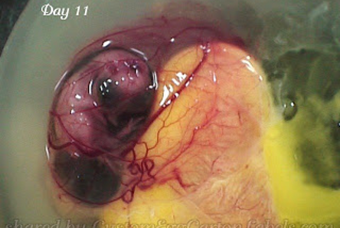
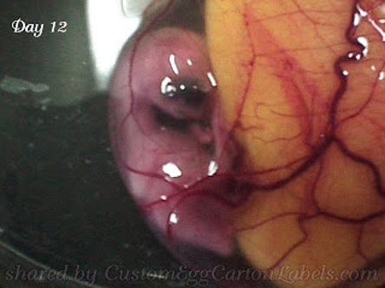
Daily Embryonic Development
Day 10: Egg tooth is prominent. Toenails are visible.
Day 11: Tail feathers are apparent.
Day 12: Toes fully formed. First visible feathers.

Slide 26
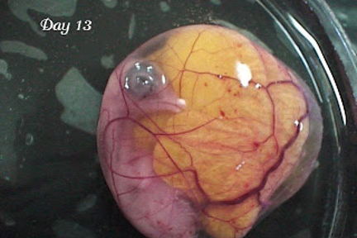
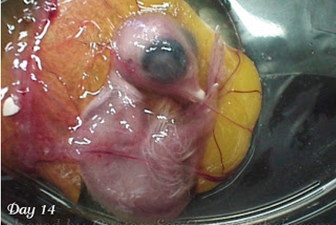
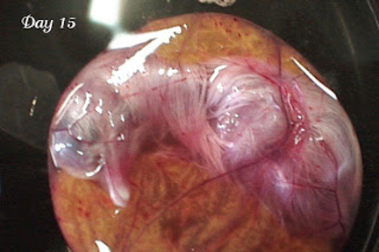
Daily Embryonic Development
Day 13: Appearance of scales, body covered lightly with feathers.
Day 14: Embryo turns head towards large end of the egg.
Day 15: Gut is drawn into abdominal cavity.

Slide 27
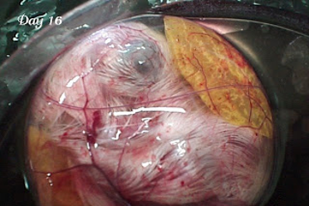
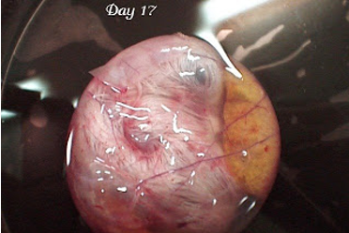
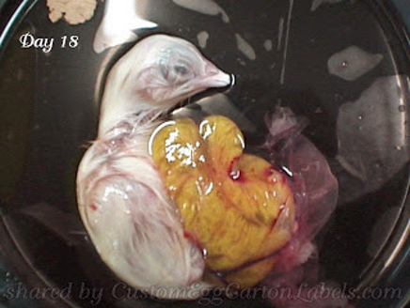
Daily Embryonic Development
Day 16: Feathers cover the body, and albumen is nearly gone.
Day 17: Amniotic fluid decreases. Head is between the legs.
Day 18: Head under right wing. Yolk sac remains outside of the embryo.

Slide 28
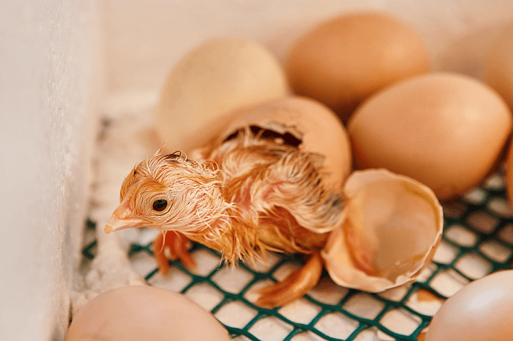
Daily Embryonic Development
Day 19: Yolk sac draws into the abdomen. Amniotic fluid is gone, and the embryo fills the egg.
Day 20: Yolk sac draws into the body cavity, and the embryo is now a chick with the ability to breathe.
Day 21: Hatching Day! Internal/external pipping (pecking) allows chick to break out of its shell.

Slide 30
Evaluating Chick Quality
Livability: 3-4 days after placement (Hatchery to blame at this point)
Productivity: Body weight gain
Check Weight at Hatch or 1 Day: Highly correlated with optimum performance
Appearance of Chick: Bright eyes, clean, sealed navel
Activity: Very active, moving to feed and water
Free of navel buttons and any wicks (strings from navel)
No red hocks or red beaks

Slide 31
Poultry Science Curriculum References
Jessica Fife, UGA Dept. of Poultry Science Outreach Coordinator, UGA Dept. of Agricultural Leadership, Education, & Communication MAEE Candidate
Barry Croom, UGA Dept. of Agricultural Leadership, Education, & Communication Professor
Ashley Yopp, UGA Dept. of Agricultural Leadership, Education, & Communication Assistant Professor
Georgia Agriculture Education
Andrew Benson, UGA Dept. of Poultry Science Assistant Professor
Brian Jordan, UGA Dept. of Poultry Science Assistant Professor, UGA College of Veterinary Medicine Assistant Professor
University of Arkansas Bumpers College of Poultry Science – Poultry Science Dual Curriculum Course
Julia Gaskin, UGA Dept. of Crop and Soil Sciences Sr. Public Service Associate
Glendon Harris, UGA Dept. of Crop and Soil Sciences Professor & Extension Agronomist
Brian Kiepper, UGA Dept. of Poultry Science Associate Professor
Claudia Dunkley, UGA Dept. of Poultry Science Public Service Associate
Casey Ritz, UGA Dept. of Poultry Science Professor
USPOULTRY & USPOULTRY Poultry Science Curriculum
Tom Tabler, Mississippi State University Department of Poultry Science Extension Professor
Jacquie Jacob, University of Kentucky
Jeanna Wilson, UGA Dept. of Poultry Science Professor
Kelly Sweeney, UGA Dept. of Poultry Science Ph.D Candidate
Merck Veterinary Manual
University of Maryland Extension
Poultry Hub
Brian Fairchild, University of Georgia Department of Poultry Science Professor
Centers for Disease Control
National FFA Organization

